Slide 1
Image courtesy of NASA/GSFC

Slide 2
Global Environmental Change: Technology and the Future of Planet Earth
Eugene S. Takle
Professor
Department of Agronomy
Department of Geological and Atmospheric Science
Director, Climate Science Program
Iowa State University
Ames, IA 50011
Technology, Globalization, and Culture
ME/WLC 484
Ames Iowa
13 September 2011

Slide 3
Climate change is one of the most important issues facing humanity
The scientific evidence clearly indicates that our climate is changing, and that human activities have been identified as a dominant contributing cause.
Don Wuebbles
Notes:
No disagreement in peer reviewed literature
Powerful statements from every major professional science society and organization in the world
Powerful statements from the National Academies of Sciences (the leadership in science) for every major country
G8 + 5 other countries, May 2009: “The need for urgent action to address climate change is now indisputable.”

Slide 4
Outline
Scientific evidence for global climate change
Changes in Iowa
Impacts of climate change on Iowa agriculture
Alternative projections of climate futures
The need for long-term mitigation that starts now

Slide 5
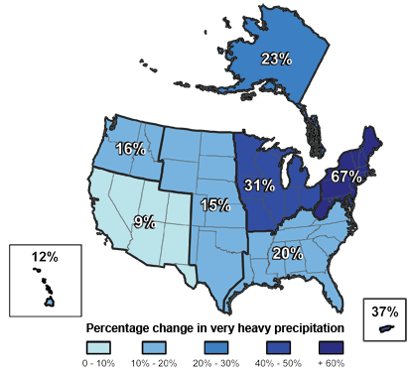
Climate changes are underway in the U.S. and are projected to grow
Temperature rise
Sea-level rise
Increase in heavy downpours
Rapidly retreating glaciers
Thawing permafrost
Lengthening growing season
Lengthening ice-free season in the ocean and on lakes and rivers
Earlier snowmelt
Changes in river flows
Plants blooming earlier; animals, birds and fish moving northward
Don Wuebbles

Slide 6
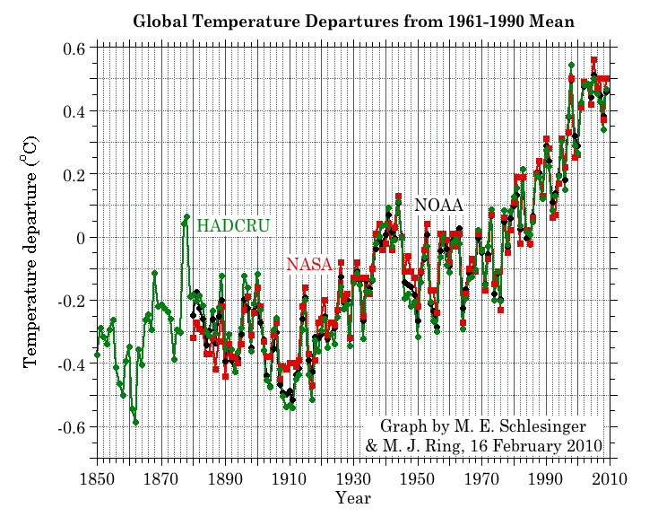
Three separate analyses of the temperature record – Trends are in close agreement
2010 tied 2005 as the warmest year on record since 1880

Slide 7
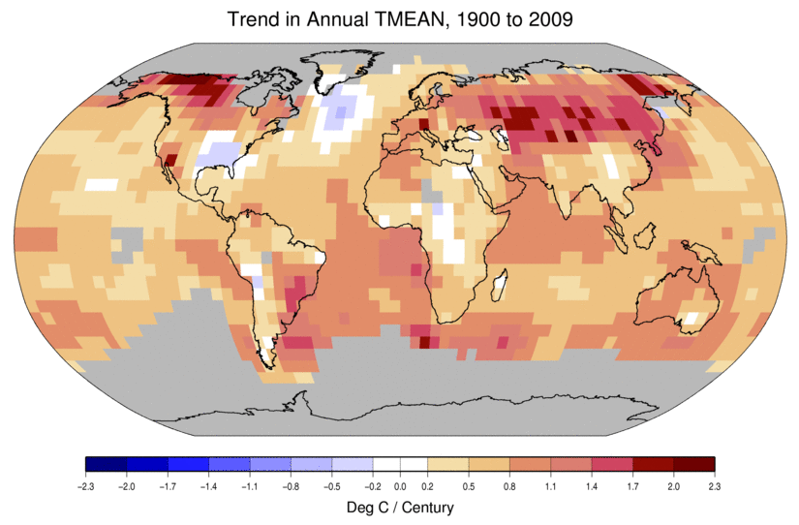
Temperature Changes are Not Uniform Around the Globe
From Tom Karl, NOAA NCDC

Slide 8
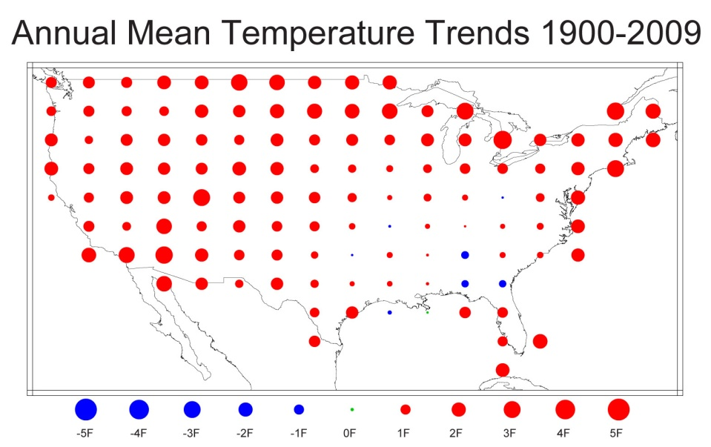
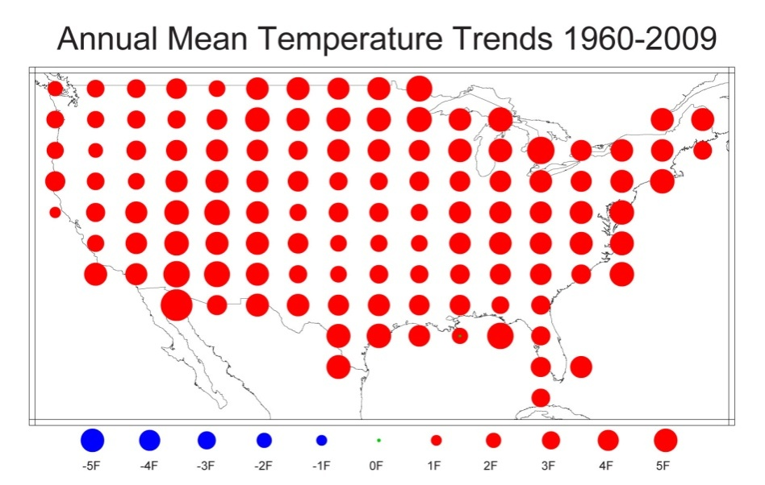
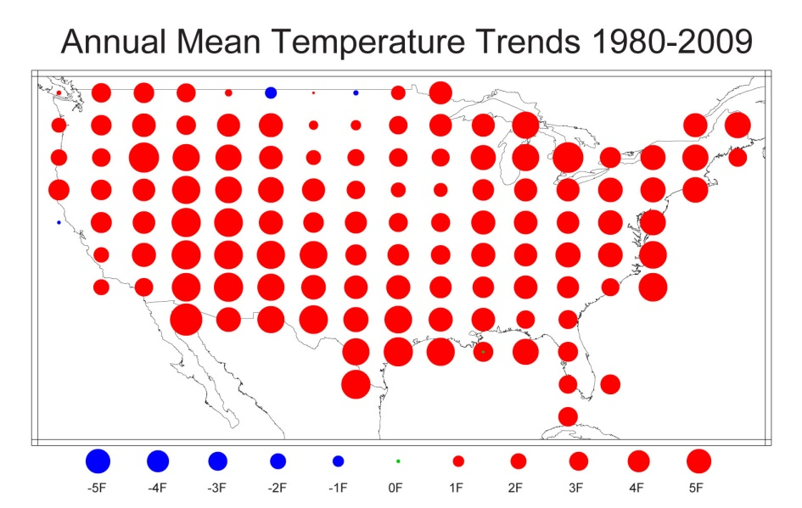
U.S. Temperature Trends
U.S. average temperature has risen more than 2ºF over the past 50 years
From Tom Karl, NOAA NCDC

Slide 9
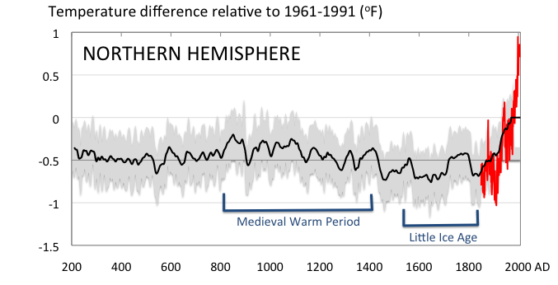
Conditions today are unusual in the context of the last 2,000 years …
Don Wuebbles

Slide 10
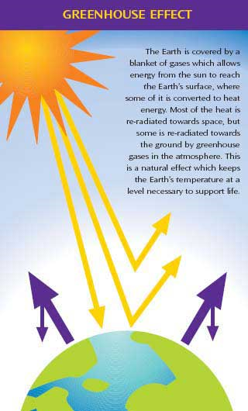
Why does the Earth warm? 1. Natural causes
THE GREENHOUSE EFFECT…
…is 100% natural.
Heat is trapped in the atmosphere.
…sustains life on Earth.
Keeps average temperatures at 12.8ºC (55ºF), instead of –29ºC (-20ºF).
Don Wuebbles

Slide 11
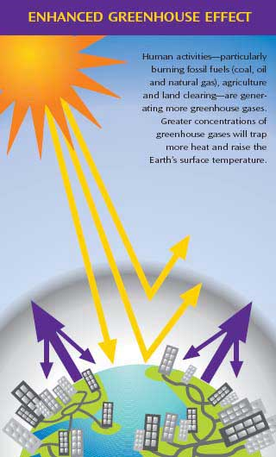
Why does the Earth warm? 2. Human causes
THE ENHANCED GREENHOUSE EFFECT
(or GLOBAL WARMING)
… is primarily human-induced: We’re increasing heat-trapping gases in the atmosphere.
… is like wrapping an extra blanket around the Earth.
Don Wuebbles

Slide 12
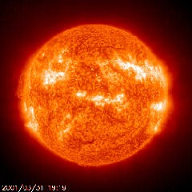
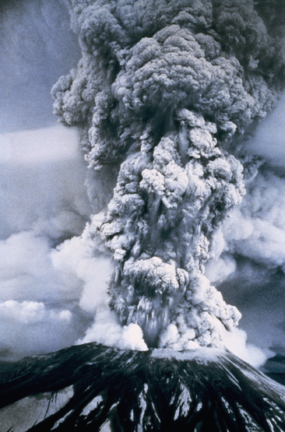
Natural factors affect climate
Variations in the energy
received from the sun
Variations in the Earth's orbit
(Milankovic effect)
Stratospheric
aerosols from
energetic
volcanic eruptions
Chaotic interactions in
the Earth's climate
(for example, El Nino, NAO)
Don Wuebbles

Slide 13
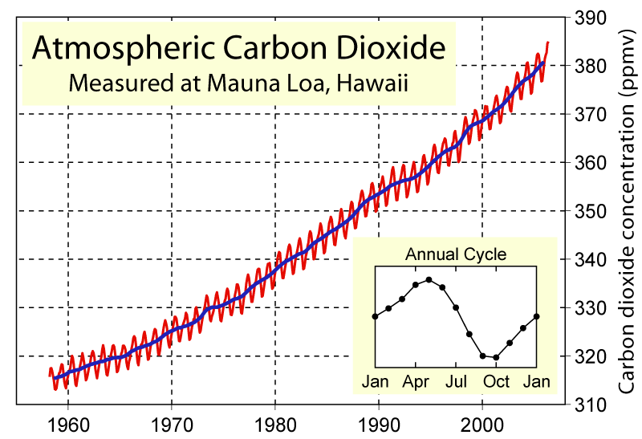
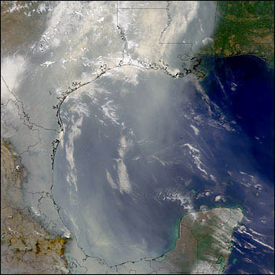
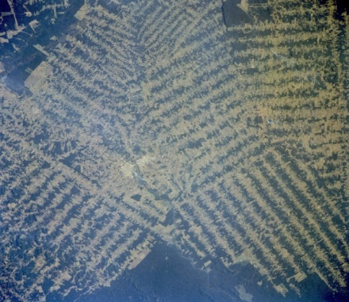
Non-natural mechanisms
Changes in atmospheric concentrations of radiatively important gases
Changes in aerosol particles from burning fossil fuels and biomass
Changes in the reflectivity (albedo) of the Earth’s surface
Don Wuebbles

Slide 14
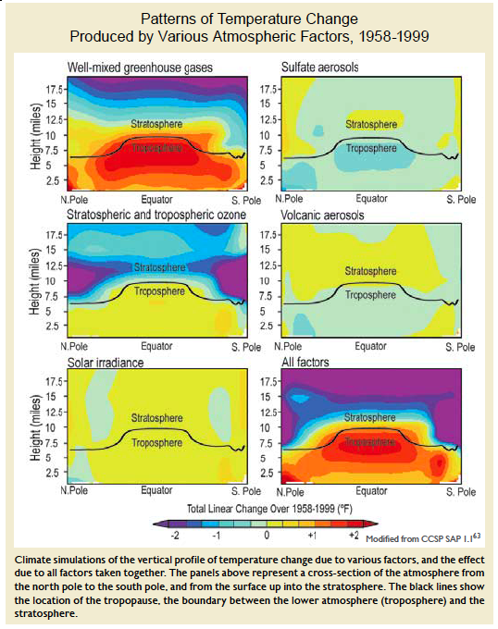
Warming of the Lower and Upper Atmosphere Produced by Natural and Human Causes
Karl, T. R., J. M. Melillo, and T. C. Peterson, (eds.), 2009: Global Climate Change Impacts in the United States. Cambridge University Press, 2009, 196pp.

Slide 15
Warming of the Lower and Upper Atmosphere Produced by Natural and Human Causes
Note that greenhouse gases have a unique temperature signature, with strong warming in the upper troposphere, cooling in the lower stratosphere and strong warming at the surface over the North Pole. No other warming factors have this signature.
Karl, T. R., J. M. Melillo, and T. C. Peterson, (eds.), 2009: Global Climate Change Impacts in the United States. Cambridge University Press, 2009, 196pp.

Slide 16
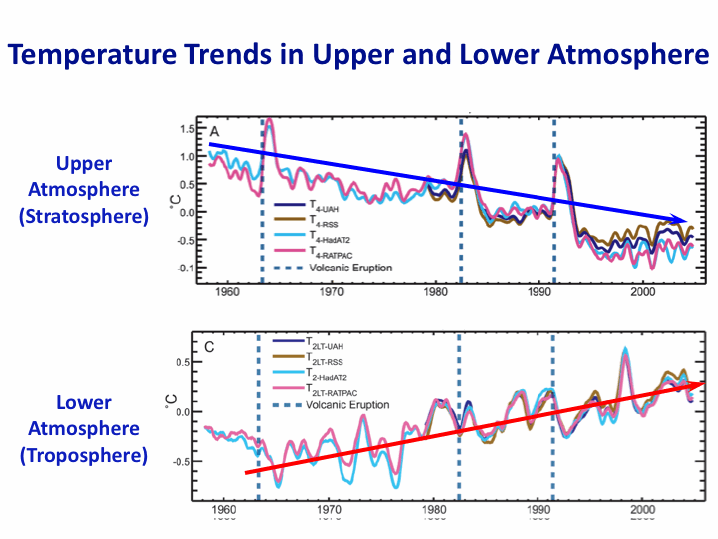
Warming of the Lower and Upper Atmosphere Produced by Natural and Human Causes
Note that greenhouse gases have a unique temperature signature, with strong warming in the upper troposphere, cooling in the lower stratosphere and strong warming at the surface over the North Pole. No other warming factors have this signature.
Karl, T. R., J. M. Melillo, and T. C. Peterson, (eds.), 2009: Global Climate Change Impacts in the United States. Cambridge University Press, 2009, 196pp.

Slide 17
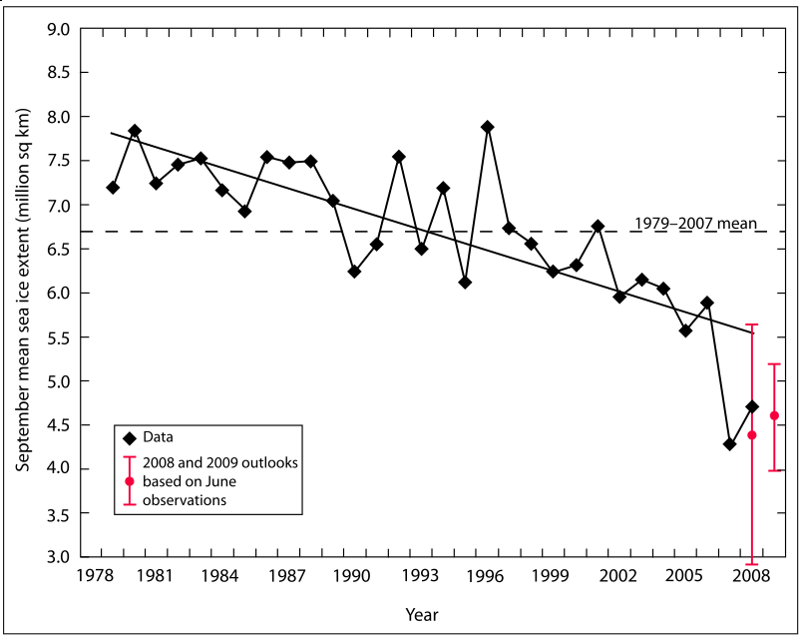
Warming of the Lower and Upper Atmosphere Produced by Natural and Human Causes
Note that greenhouse gases have a unique temperature signature, with strong warming in the upper troposphere, cooling in the lower stratosphere and strong warming at the surface over the North Pole. No other warming factors have this signature.

Slide 18
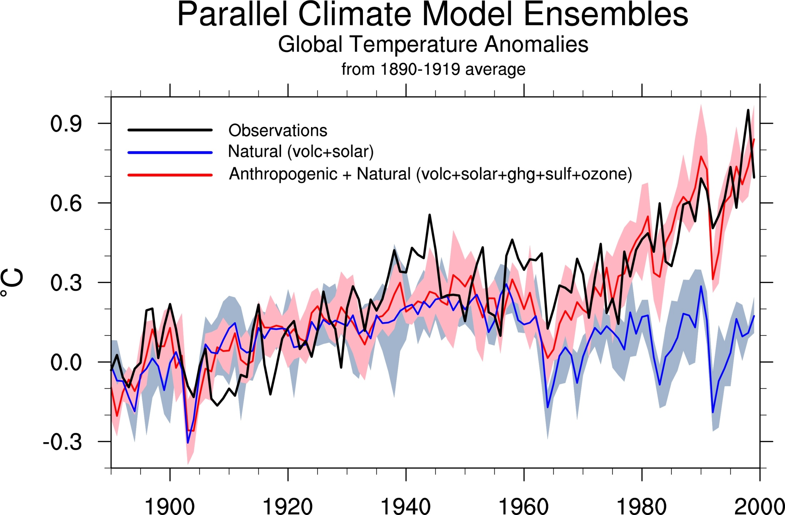
Climate models: Natural processes do not account for
observed 20th century warming after 1965
Don Wuebbles

Slide 19
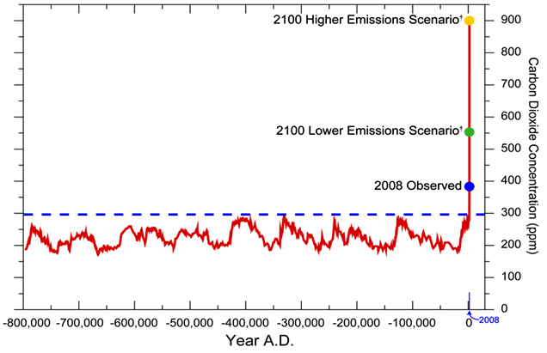
We have Moved Outside the Range of Historical Variation
800,000 Year Record of Carbon Dioxide Concentration
Don Wuebbles

Slide 20
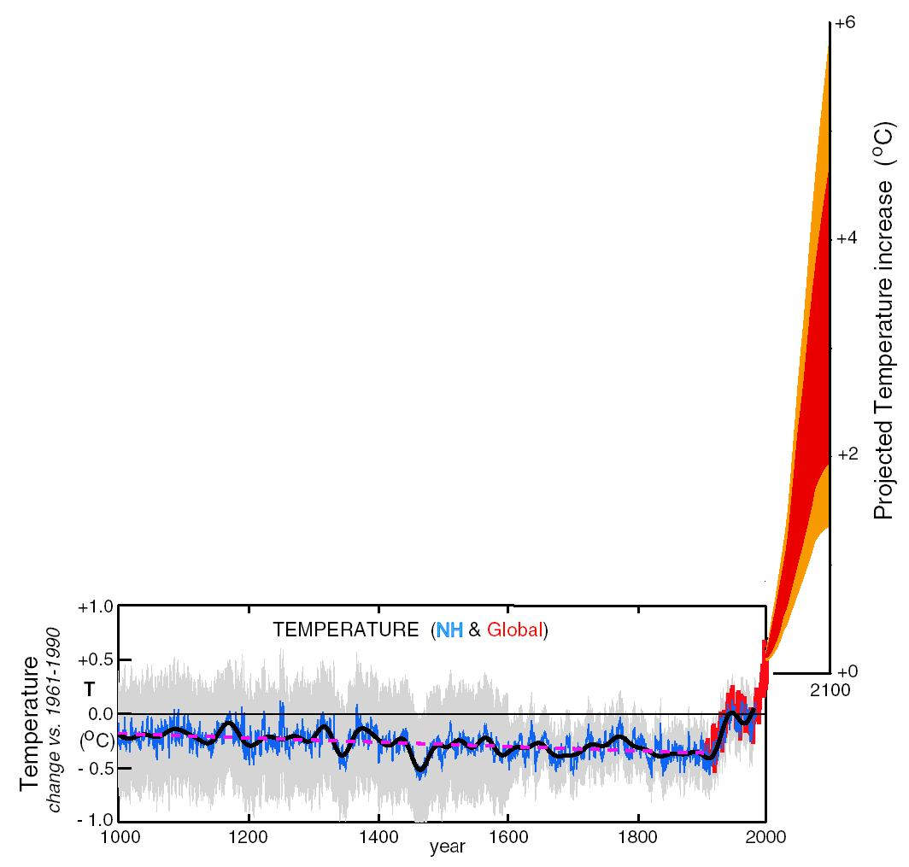
What can we expect in the future?
Don Wuebbles

Slide 21
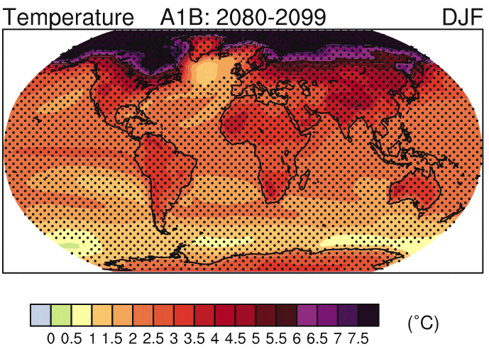
IPCC 2007

Slide 22
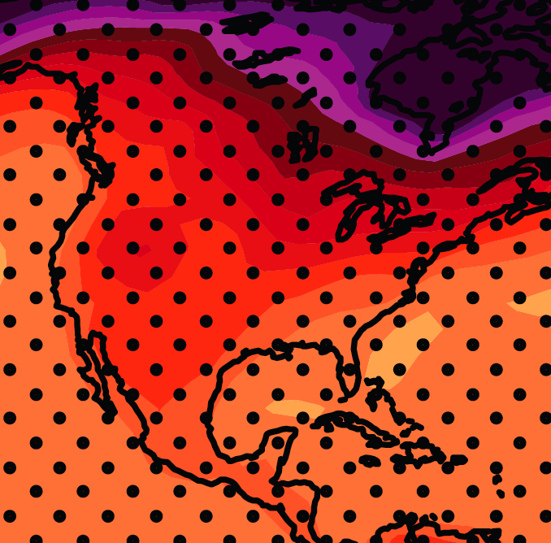
December-January-February Temperature Change
7.2ºF
6.3ºF
A1B Emission Scenario
2080-2099 minus1980-1999

Slide 23
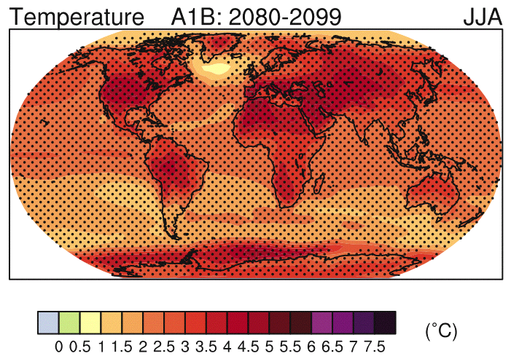
IPCC 2007

Slide 24
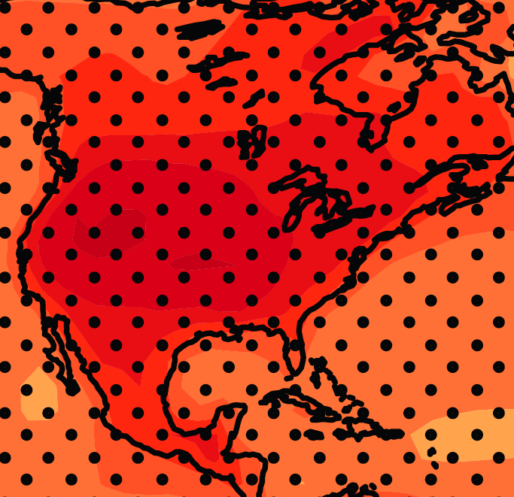
June-July-August Temperature Change
4.5ºF
5.4ºF
A1B Emission Scenario
2080-2099 minus1980-1999

Slide 25
June-July-August Temperature Change
4.5ºF
5.4ºF
Not the direction of current trends
A1B Emission Scenario
2080-2099 minus1980-1999

Slide 26
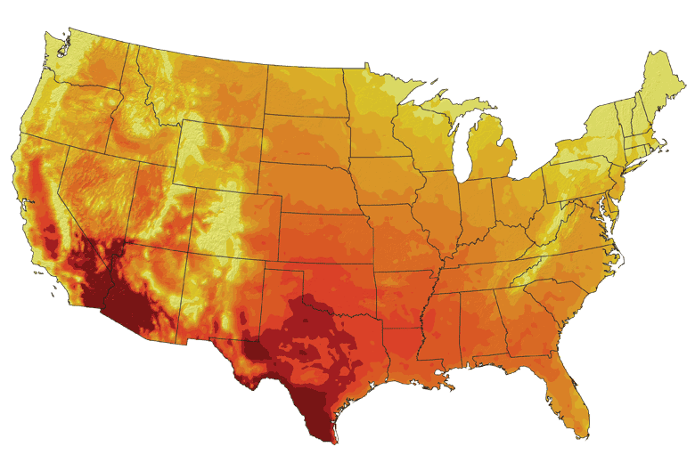
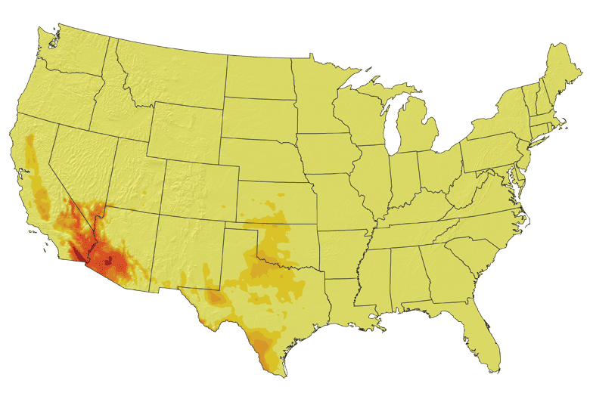
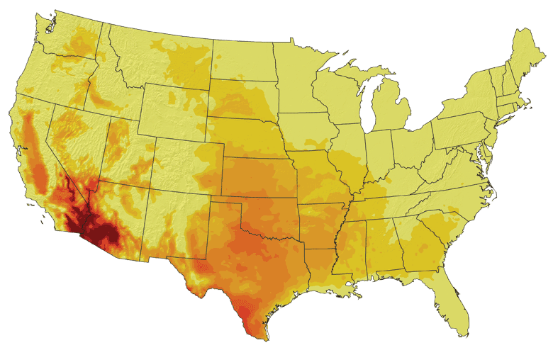
Increases in very high temperatures will have
wide-ranging effects
Higher Emissions Scenario, 2080-2099
Number of Days Over 100ºF
Recent Past, 1961-1979
Average:
30-60 days
Lower Emissions Scenario, 2080-2099
Average:
10-20 days
Don Wuebbles

Slide 27
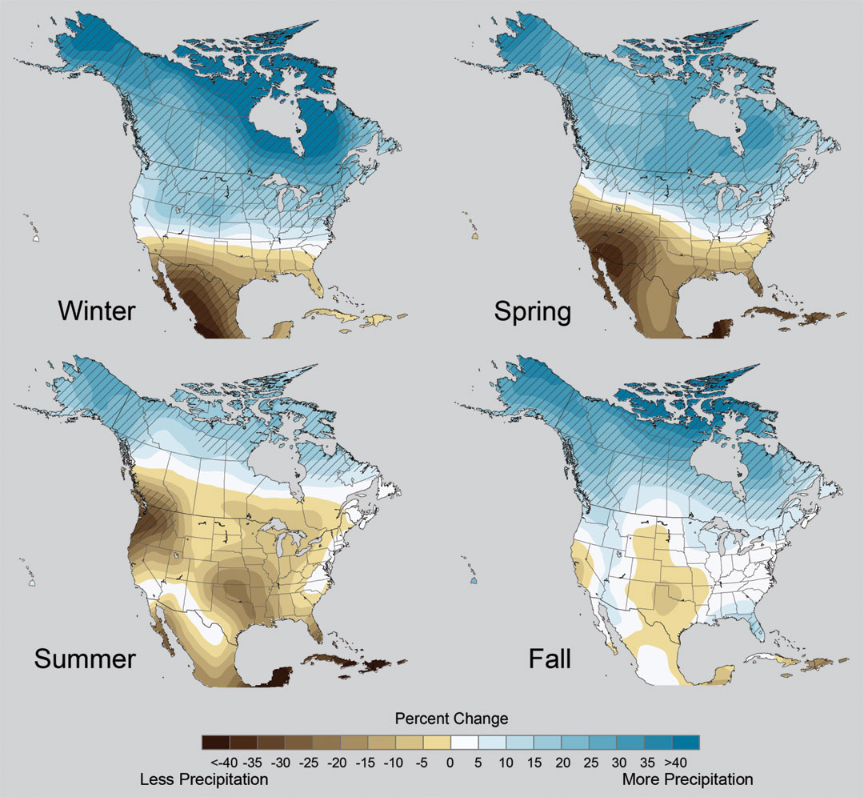
Projected Change in Precipitation: 2081-2099
Midwest: Increasing winter and spring precipitation, with drier summers
More frequent and intense periods of heavy rainfall
Unstippled regions indicate reduced confidence
Relative to 1960-1990
NOTE: Scale Reversed
Don Wuebbles

Slide 28
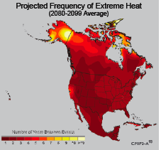
Extreme weather events become more common
Events now considered rare will become commonplace.
Heat waves will likely become longer and more severe
Droughts are likely to become more frequent and severe in some regions
Likely increase in severe thunderstorms (and perhaps in tornadoes).
Winter storm tracks are shifting
northward and the strongest storms are
likely to become stronger and more
frequent.
Don Wuebbles
Notes:
Shown here is the frequency at the end of the century of what we consider now to be a 20 year heat wave. Instead of once every 20 years, these temperatures would be experienced every other year or so over most of the continental US in this business as usual scenario.

Slide 29
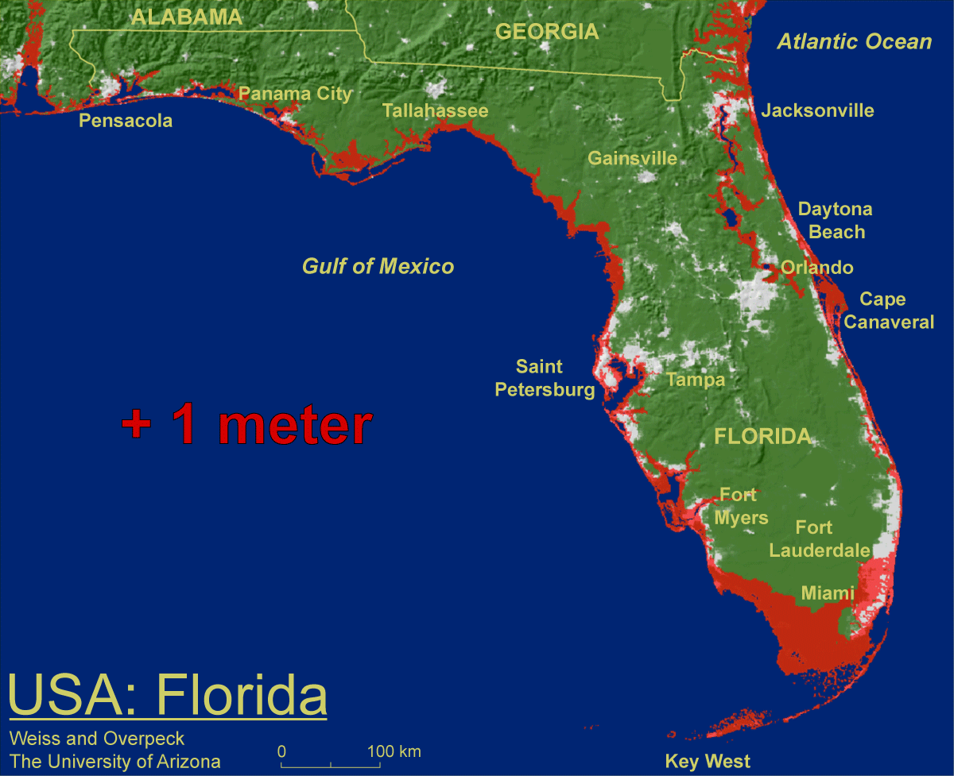
1 meter will be hard to avoid, possibly within this century, just from thermal expansion and small glacier melt.
Don Wuebbles

Slide 30
Widespread climate-related impacts are occurring now and are expected to increase
Water Resources
Energy Supply & Use
Transportation
Agriculture
Don Wuebbles
Ecosystems
Human Health
Society

Slide 31
First Date Iowa’s Average Fall 4-inch Soil Temperature Was Below 50ºF
Iowa Environmental Mesonet 2010

Slide 32
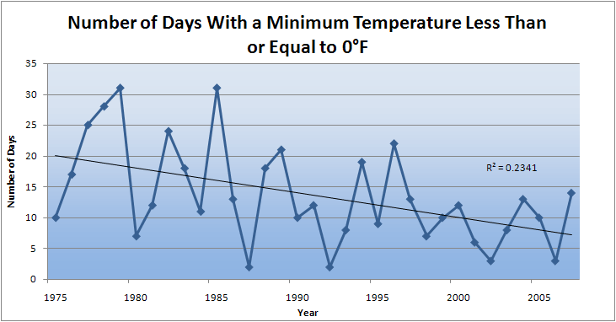
Des Moines Airport Data
Caution: Not corrected for urban heat island effects

Slide 33
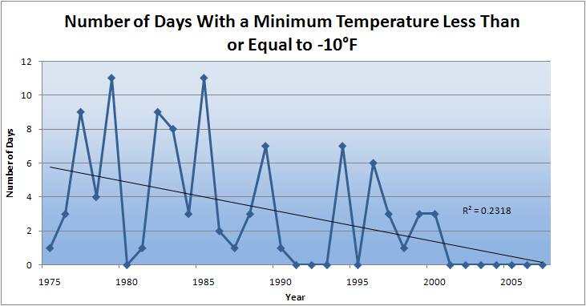
Des Moines Airport Data
Caution: Not corrected for urban heat island effects

Slide 34
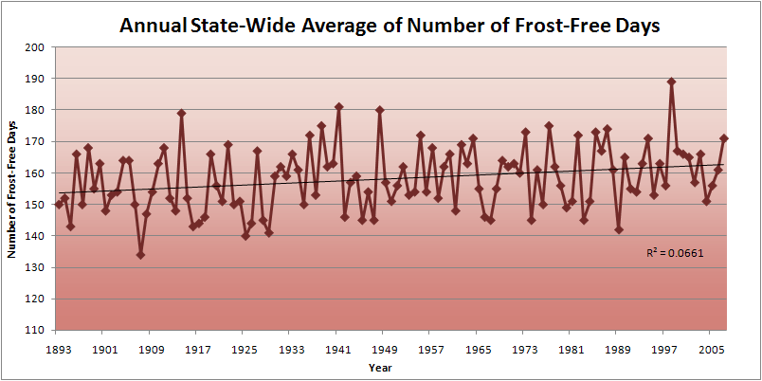
Iowa State-Wide Average Data

Slide 35
Des Moines Airport Data
1983: 13
1988: 10
1977: 8
6 days ≥ 100ºF in the last 22 years

Slide 38
Summer (JJA) Cloud Cover, Des Moines

Slide 39
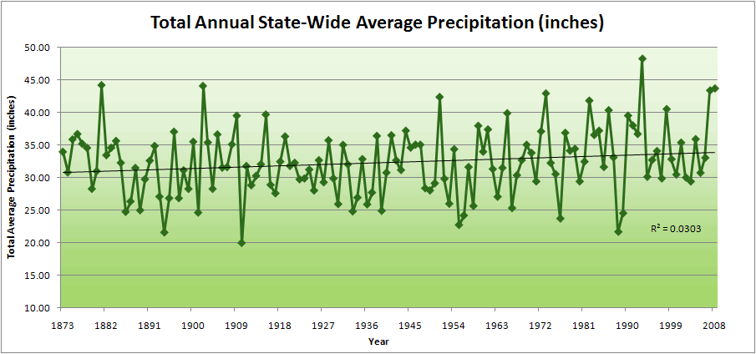
Iowa State-Wide Average Data

Slide 40
Iowa State-Wide Average Data
34.0”
10% increase
30.8”

Slide 41
Iowa State-Wide Average Data
Totals above 40”
2 years

Slide 42
Iowa State-Wide Average Data
Totals above 40”
8 years
2 years

Slide 43
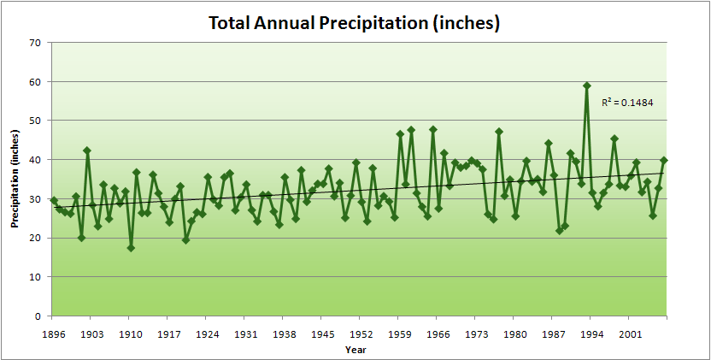
Cedar Rapids Data

Slide 44
Cedar Rapids Data
28.0”
32% increase
37.0”

Slide 45
Cedar Rapids Data
Years with more than 40 inches
1
28.0”
32% increase
37.0”

Slide 46
Cedar Rapids Data
Years with more than 40 inches
11
1
28.0”
32% increase
37.0”

Slide 47
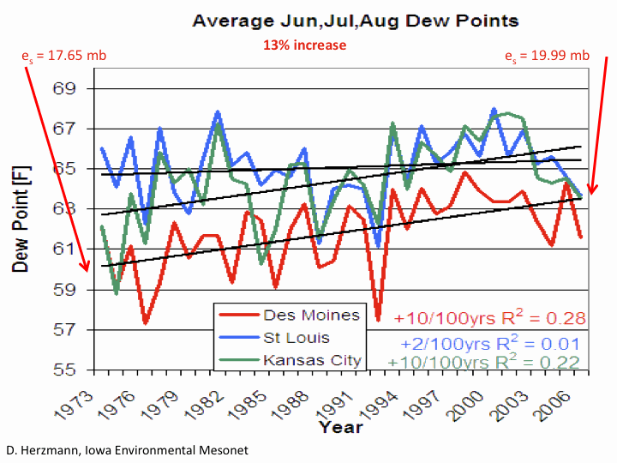

Slide 48
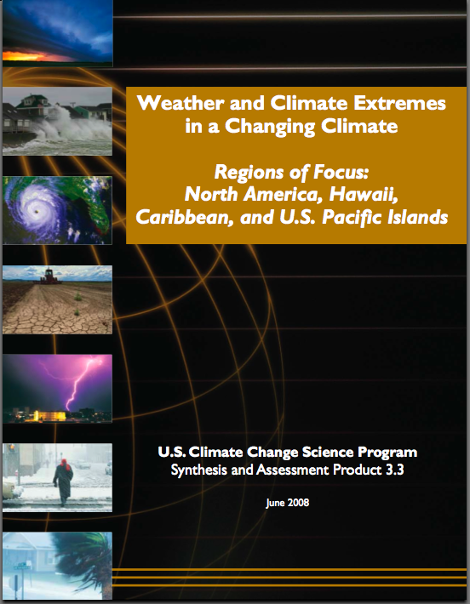
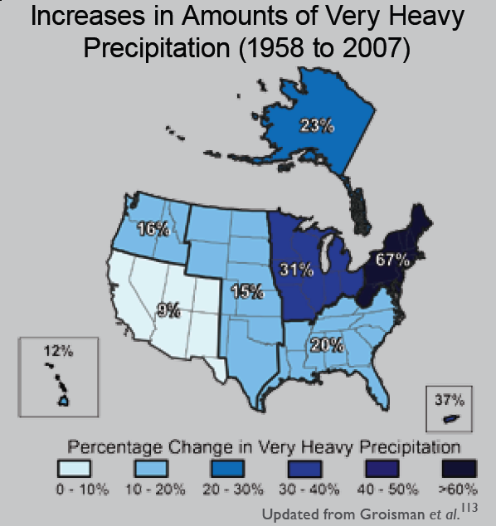
“One of the clearest trends in the United States observational record is an increasing frequency and intensity of heavy precipitation events… Over the last century there was a 50% increase in the frequency of days with precipitation over 101.6 mm (four inches) in the upper midwestern U.S.; this trend is statistically significant “
Karl, T. R., J. M. Melillo, and T. C. Peterson, (eds.), 2009: Global Climate Change Impacts in the United States. Cambridge University Press, 2009, 196pp.

Slide 49
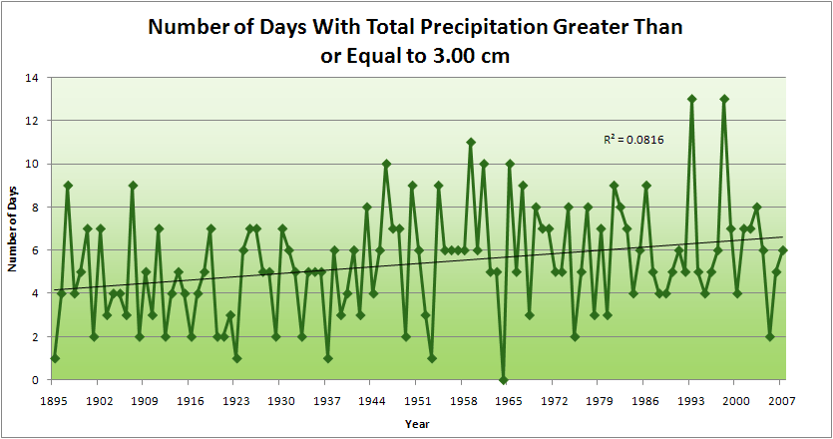
Cedar Rapids Data
1.25 inches
4.2 days
57% increase
6.6 days

Slide 50
Cedar Rapids Data
1.25 inches
Years having more than 8 days
13
2
4.2 days
57% increase
6.6 days

Slide 51
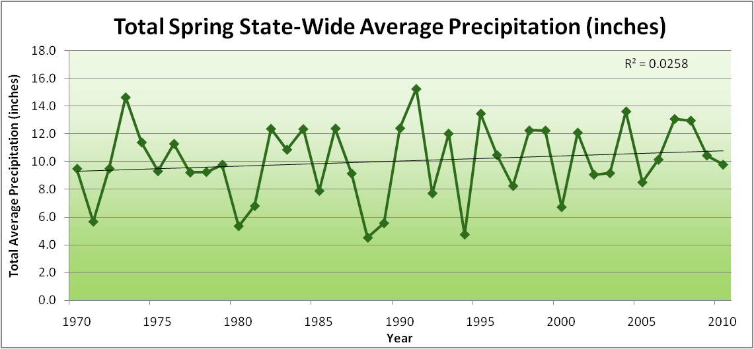
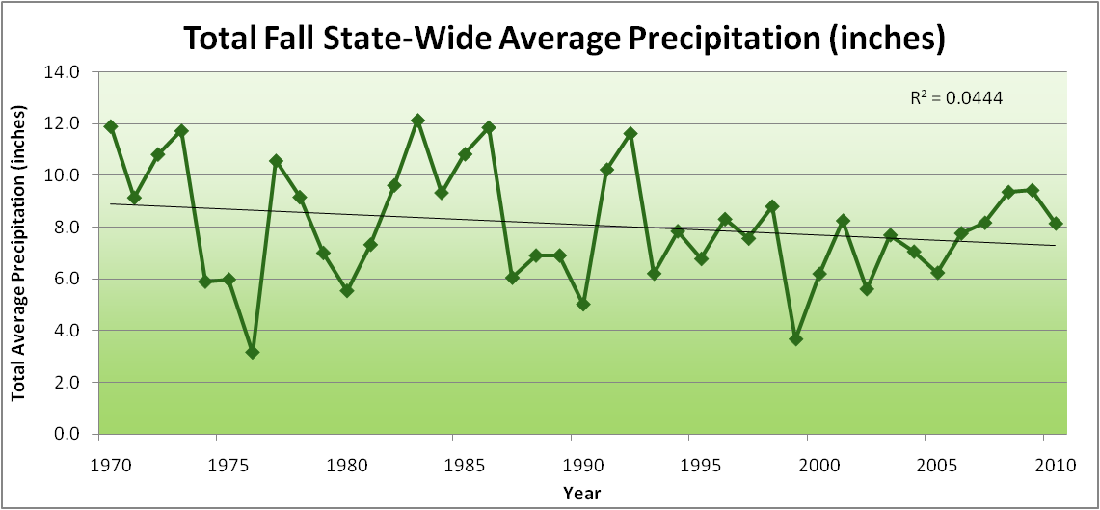
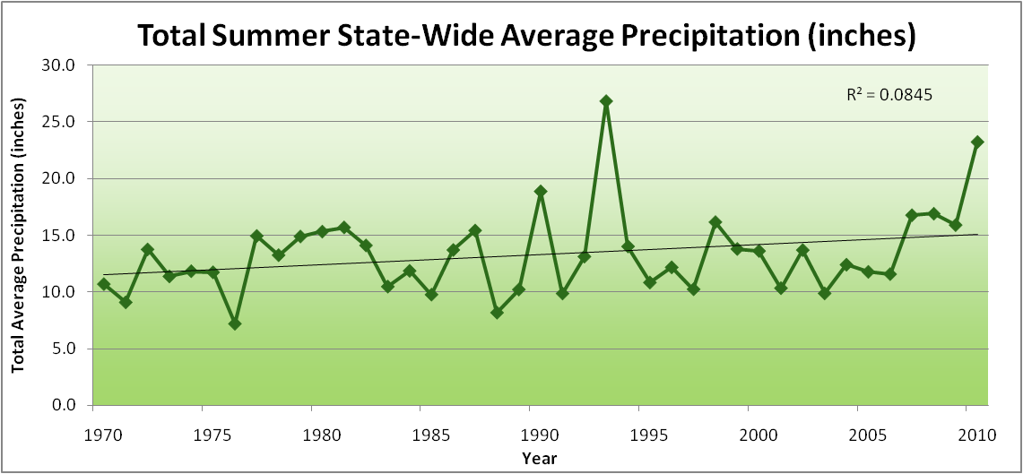
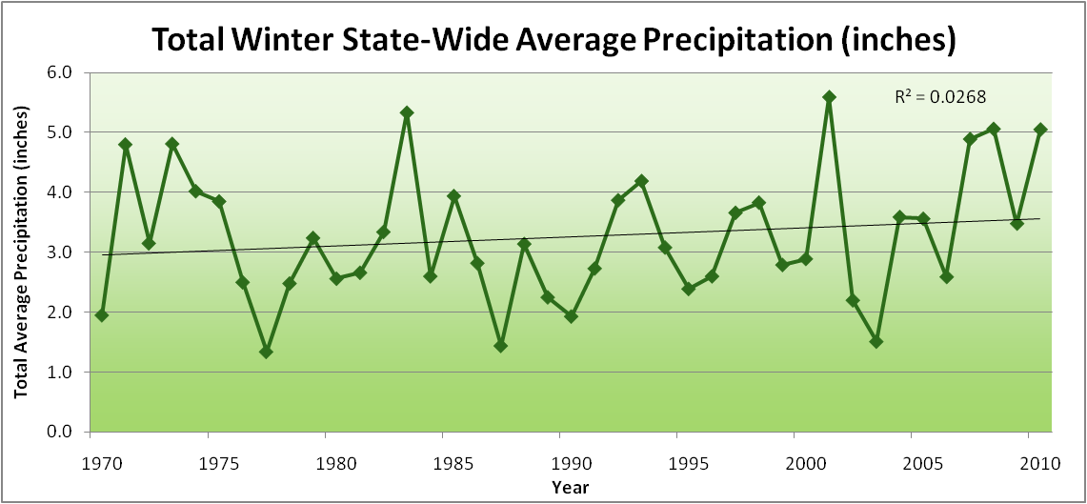
Amplification of the Seasonality of Precipitation
Spring
Fall
Summer
Winter

Slide 52
Amplification of the Seasonality of Precipitation
Spring
Fall
Summer
Winter

Slide 53
Amplification of the Seasonality of Precipitation
Spring
Fall
Summer
Winter

Slide 54
Amplification of the Seasonality of Precipitation
Spring
Fall
Summer
Winter

Slide 55
Amplification of the Seasonality of Precipitation
Spring
Fall
Summer
Winter

Slide 56
Amplification of the Seasonality of Precipitation
Spring
Fall
Summer
Winter

Slide 57
Amplification of the Seasonality of Precipitation
Spring
Fall
Summer
Winter

Slide 58
Amplification of the Seasonality of Precipitation
Spring
Fall
21.2 => 25.3 inches (22% increase)
12.1 => 10.5 inches (13% decrease)
Summer
Winter

Slide 59
Iowa Agricultural Producers’ Adaptations to Climate Change
Longer growing season: plant earlier, plant longer season hybrids, harvest later
Wetter springs: larger machinery enables planting in smaller weather windows
More summer precipitation: higher planting densities for higher yields
Wetter springs and summers: more subsurface drainage tile is being installed, closer spacing, sloped surfaces
Fewer extreme heat events: higher planting densities, fewer pollination failures
Higher humidity: more spraying for pathogens favored by moist conditions. more problems with fall crop dry-down, wider bean heads for faster harvest due to shorter harvest period during the daytime.
Drier autumns: delay harvest to take advantage of natural dry-down conditions
HIGHER YIELDS!!
Is it genetics or climate? Likely some of each.

Slide 60
Why Small Changes in Rainfall Produce Much More Flooding
13% increase in atmospheric moisture in June-July-August
~10% increase in average precipitation in Iowa
~5-fold increase in high-precipitation events, mostly in June-July-August, that lead to runoff
Iowa rivers and watersheds are oriented NW-SE
Rainfall patterns turn from SW-NE in March-May to W-E or NW-SE in mid summer
More frequent floods are the result of one or more of the following
More rain
More intense rain events
More rain in the summer
Rainfall patterns more likely to align with streams and watersheds
Streams amplify changes in precipitation by a factor of 2-4
AND: more subsurface drainage tile has been installed

Slide 61
Climate trends of the recent past have low statistical significance. Nevertheless, they have forced significant agricultural and societal adaptation:

Slide 62
Climate trends of the recent past have low statistical significance. Nevertheless, they have forced significant agricultural and societal adaptation:
Even climate trends of low statistical significance can have impacts of high agricultural and societal significance

Slide 63
Visioning Your Future Climate: You be the Scientist. For Which Scenario Can You Find the Most Evidence?

Slide 64
Visioning Your Future Climate: You be the Scientist. For Which Scenario Can You Find the Most Evidence?
You are here

Slide 65
Visioning Your Future Climate: You be the Scientist. For Which Scenario Can You Find the Most Evidence?
You are here
Today

Slide 66
Visioning Your Future Climate: You be the Scientist. For Which Scenario Can You Find the Most Evidence?
You are here
Today
Past

Slide 67
Visioning Your Future Climate: You be the Scientist. For Which Scenario Can You Find the Most Evidence?
You are here
Today
Past
Future

Slide 68
Visioning Your Future Climate: You be the Scientist. For Which Scenario Can You Find the Most Evidence?
You are here
Today
Past
Future

Slide 69
Visioning Your Future Climate: You be the Scientist. For Which Scenario Can You Find the Most Evidence?
You are here
?
Today
Past
Future

Slide 70
Visioning Your Future Climate: You be the Scientist. For Which Scenario Can You Find the Most Evidence?
?
Some Climate Variable (temp, precip, humid)
Today
Past
Future

Slide 71
Visioning Your Future Climate: You be the Scientist. For Which Scenario Can You Find the Most Evidence?
Some Climate Variable (temp, precip, humid)
Measured past
Today
Past
Future

Slide 72
Visioning Your Future Climate: You be the Scientist. For Which Scenario Can You Find the Most Evidence?
Some Climate Variable (temp, precip, humid)
Future will return to something in the past
Measured past
Today
Past
Future

Slide 73
Visioning Your Future Climate: You be the Scientist. For Which Scenario Can You Find the Most Evidence?
Future will be like average of the past
Some Climate Variable (temp, precip, humid)
Future will return to something in the past
Measured past
Today
Past
Future

Slide 74
Visioning Your Future Climate: You be the Scientist. For Which Scenario Can You Find the Most Evidence?
Future will be like today
Future will be like average of the past
Some Climate Variable (temp, precip, humid)
Future will return to something in the past
Measured past
Today
Past
Future

Slide 75
Visioning Your Future Climate: You be the Scientist. For Which Scenario Can You Find the Most Evidence?
Current trend will continue
Future will be like today
Future will be like average of the past
Some Climate Variable (temp, precip, humid)
Future will return to something in the past
Measured past
Today
Past
Future

Slide 76
Visioning Your Future Climate: You be the Scientist. For Which Scenario Can You Find the Most Evidence?
Future will be more extreme than today
Current trend will continue
Future will be like today
Future will be like average of the past
Some Climate Variable (temp, precip, humid)
Future will return to something in the past
Measured past
Today
Past
Future

Slide 77
Visioning Your Future Climate: You be the Scientist. For Which Scenario Can You Find the Most Evidence?
Future will be more extreme than today
Current trend will continue
Future will be like today
Future will be like average of the past
Some Climate Variable (temp, precip, humid)
Future will return to something in the past
Measured past
Today
Past
Future

Slide 78
Visioning Your Future Climate: You be the Scientist. For Which Scenario Can You Find the Most Evidence?
Some Climate Variable (temp, precip, humid)
Measured past
Today
Past
Future

Slide 79
My View
Natural year-to-year variability
will dominate changes in climate
over the next 10-15 years
A Prudent View of the Future
Some Climate Variable (temp, precip, humid)
Measured past
Today
Past
Future

Slide 80
Rise in global mean temperature (ºC)

Slide 81
Rise in global mean temperature (ºC)

Slide 82
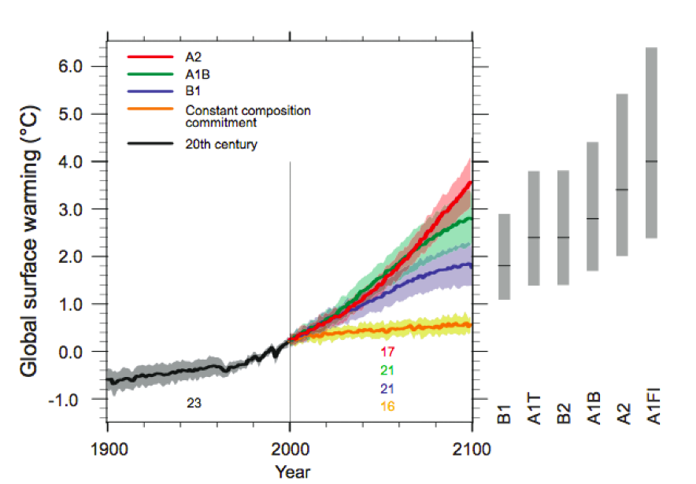
Energy intensive
Balanced fuel sources
More environmentally friendly
Limit to avoid “dangerous anthropogenic
Interference” with the climate system
2ºC limit
IPCC Fourth Assessment Report Summary for Policy Makers

Slide 83
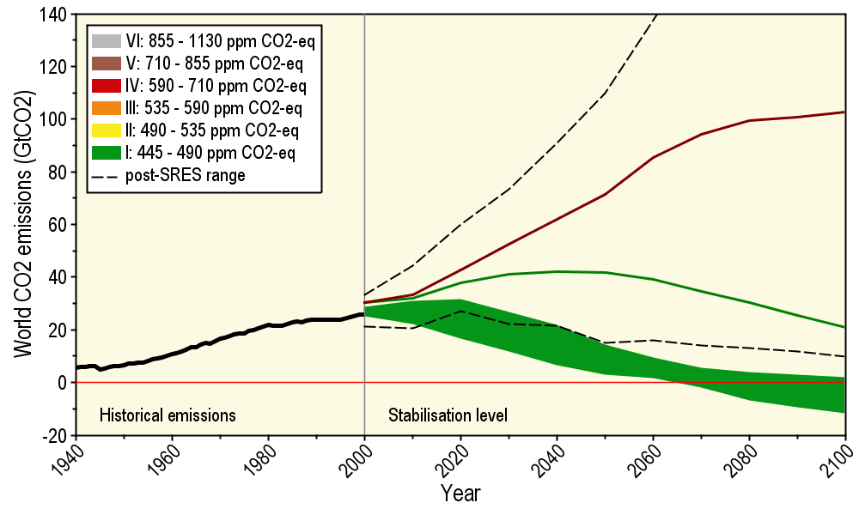
Long-Term Stabilization Profiles
A2
B1
Nebojša Nakićenović IIASA, Vienna

Slide 84
Long-Term Stabilization Profiles
A2
Achieving this emission reduction scenario will provide a 50% chance of not exceeding the 2ºC guardrail
B1
Nebojša Nakićenović IIASA, Vienna

Slide 85
“Big Fixes” for Climate UCAR Quarterly , Fall 2006
Sprinkle iron dust in the polar oceans
Inject large amounts of sulfate aerosol into the stratosphere
Launch saltwater spray to modify marine stratus clouds
Position 16,000,000,000,000 transparent, sunlight-refracting shades that would be deployed at the inner Lagrangian point of gravitational balance, about 1.5 million km from Earth toward the Sun. 20 launchers would each need to loft 800,000 screens every five minutes for ten years.

Slide 86
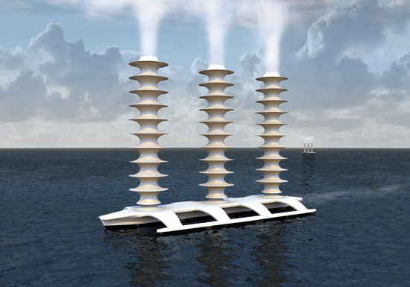
Illustration courtesy John MacNeill

Slide 87
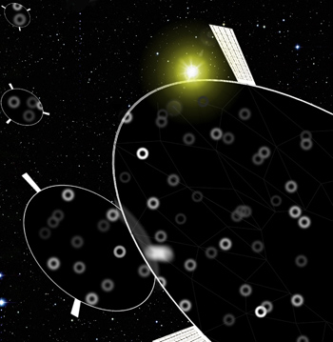
Big Fixes for Climate
UCAR Quarterly
Fall 2006
A few of the 16 trillion sunlight-refracting shades proposed for deployment. Each mirror would span less than a square meter. The use of refraction rather than reflection would diminish sunlight-induced pressure from that would otherwise shift the shades' orbit. (Image courtesy of Roger Angel, UA Steward Observatory.)

Slide 88
Summary
Global temperature trends of the 20C cannot be explained on the basis of natural variation alone
Only when the influences of greenhouse gases and sulfate aerosols are included can the trends be explained
Models that explain these trends, when projected into the future, indicate a 1.5-6.5ºC warming over the 21C
Substantial adverse consequences to sea-level rise, food production, fresh-water supplies, severe weather events, and human health will occur for temperature increases above 2ºC
“Big Fixes” have big negative side effects

Slide 89
For More Information
Contact me directly:
gstakle@iastate.edu
Current research on regional climate and climate change is being conducted at Iowa State University under the Regional Climate Modeling Laboratory
http://rcmlab.agron.iastate.edu/
North American Regional Climate Change Assessment Program
http://www.narccap.ucar.edu/
For current activities on the ISU campus, regionally and nationally relating to climate change see the Climate Science Initiative website:
http://climate.engineering.iastate.edu/
Or just Google Eugene Takle

